Slide 1

Amazon Products Review Analysis
PRESENTED BY-
ABDUL HAMEED CHANDRA PRAKASH KODAVALI SUDHAKAR PRAVEEN KUMAR

Slide 2
Content
Video Games Data and Toys and Games Data
Problem Statement
Data pre-processing
Analysis on Review
Valuable Customers
Text Analysis based on Reviews
Forecast of Positive and Negative Expressions
Dash Board
Model Evaluation
Business interpterion
Conclusion
2

Slide 3
Problem Statement
When millions of reviews are being written per day on Amazon, the old manual procedure is lengthy and ineffective. It does not reflect any recurring trends or patterns. Also, it might be hard to determine how people feel about any given product.
Which products will be popular in the future?
What we can do to improve customer retention.
What effect will a fresh review have on the product?
Product recommendation.
3

Slide 4
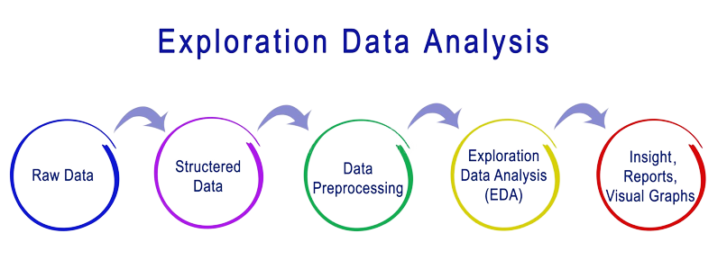
Data pre-processing :
4

Slide 5



Amazon Product Review on Video Game

Slide 6
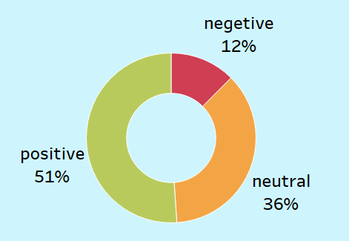
Analysis on Review
Conclusion:-
51% of the Customers like the products manufactured from Nintendo, Electronic arts, Sony, Playstation and Konami
And, We can recommend the games such as Playstation 2 Console- Black, Final Fantasy VII, Grand Theft Auto III, Jinhezo AV and Metal Gear Solid 2
6

Slide 7
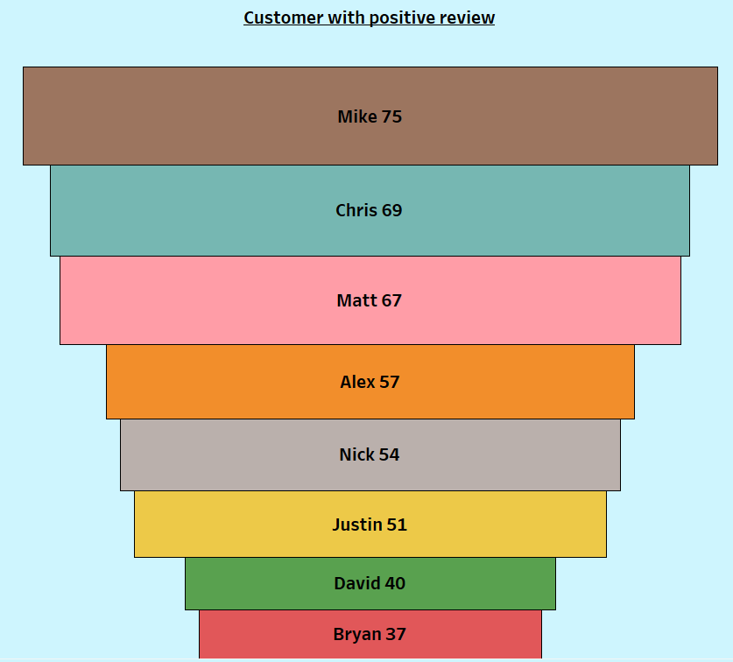
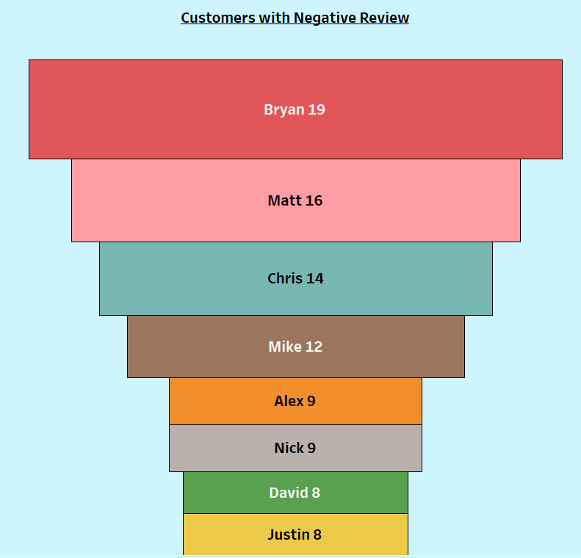
Valuable Customers
Conclusion:-
Above customers such as, Mike, Chris, Matt, Alex, Nick, Justin, David and Bryan has share the positive as well as negative review for the product.
So, we can conclude they are the genuine customers and to improve the productivity we should consider their reviews
7

Slide 8
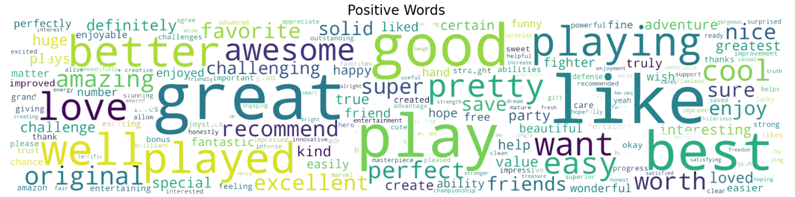
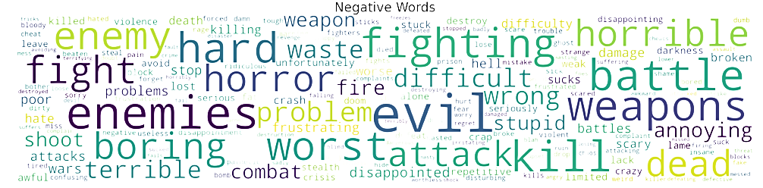
Text Analysis based on Reviews
The positive word cloud for Amazon reviews is dominated by words such as "great," "love," "amazing," and "excellent," suggesting overwhelmingly positive sentiment among reviewers. The positive word cloud overall paints a picture of a community of happy and satisfied Amazon customers
The negative word cloud features words like "disappointed," suggesting a sense of unmet expectations, and "missing," indicating a sense of loss or absence. Overall, the negative word cloud paints a picture of a person or community that is struggling with disappointment, loss, dysfunction, and a sense of waste.
8

Slide 9
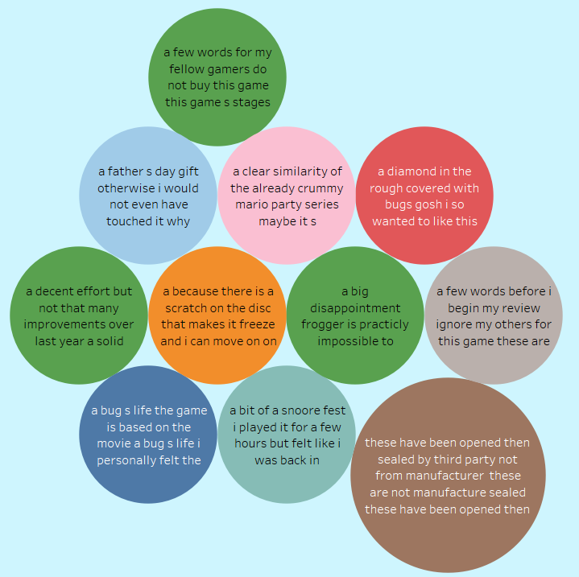
Text Analysis based on
Negative Reviews
9

Slide 10
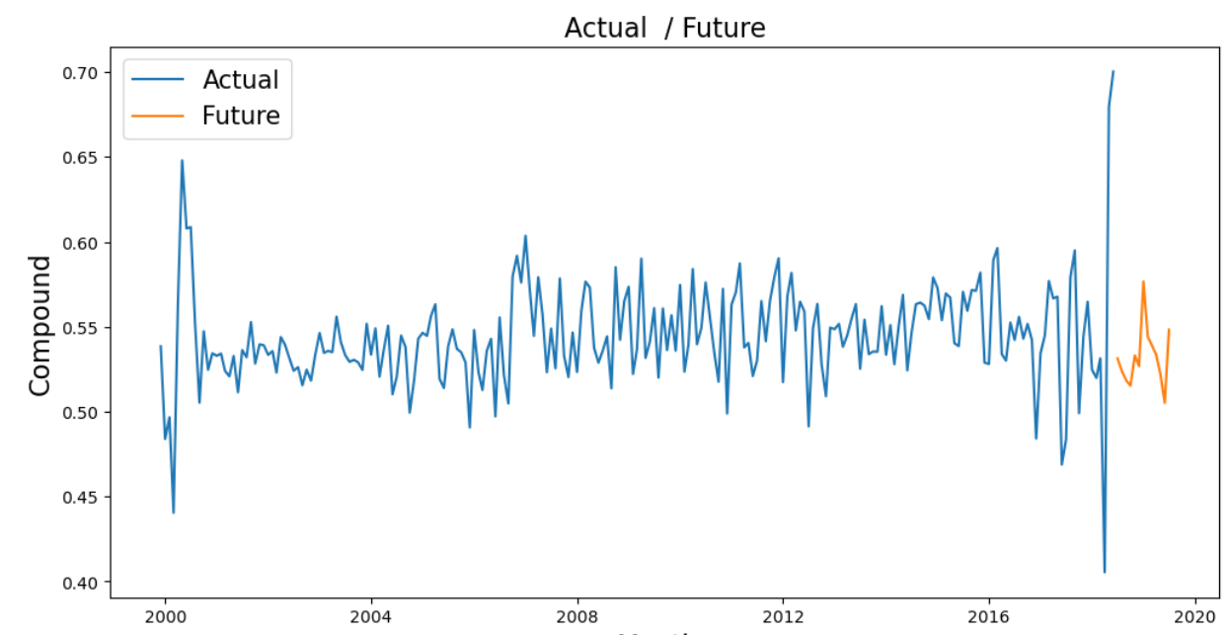
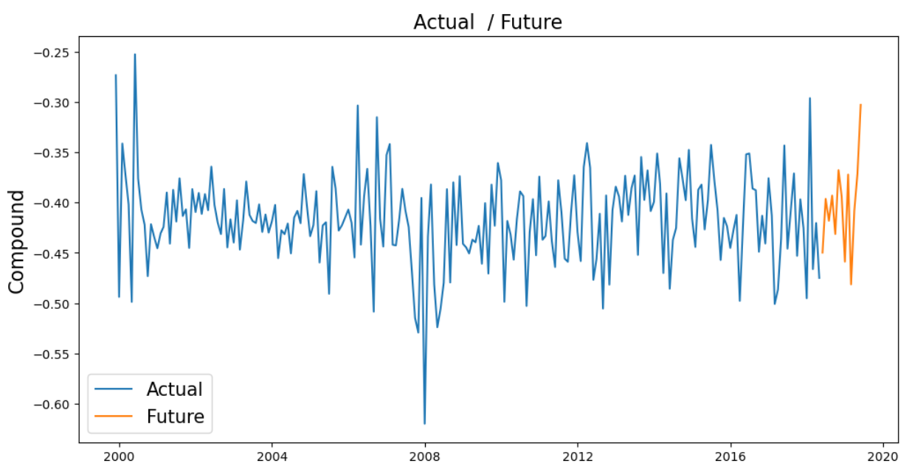
Forecast of Positive and Negative Expressions
Negative
Positive
Conclusion:- Above Plot is the future forecasting of the product positively and negatively with the use of a SARIMAX model .
10

Slide 11
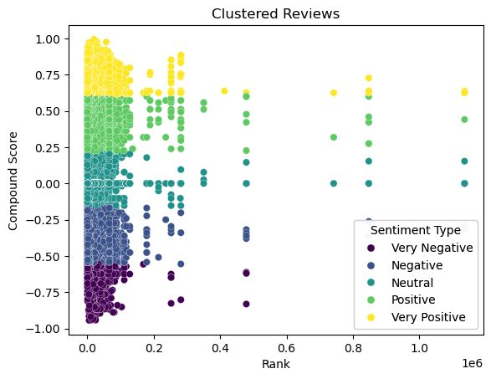
Clustering customers using Machine learning
In conclusion, our K-means clustering analysis of Amazon goods based on their rating and rank identifies five unique groups.
These clusters can help guide ranking and product strategy decisions in order to better satisfy the demands and preferences of customers.
According to rank, clusters 1 and 2 are negative, cluster 3 is neutral, and clusters 4 and 5 are positive.
11

Slide 12
MODEL EVALUATION
Video Game Data
Stacking (Logistic Regression) :
Accuracy Score : 91.21 %
F1 Score : 90.61%
Recall Score : 91.21 %
Precision Score : 91.27 %
Random forest Classifier Model :
Accuracy Score : 56.35 %
F1 Score : 67.74 %
Recall Score : 56.35 %
Precision Score : 64.28 %
In conclusion, we compare our model to logistic regression, Naive Bayes, and random forest classifiers from that logistic regression evaluation for Amazon product ratings based on review text good results measured using accuracy, F1 score, recall, precision, and a confusion matrix.
12

Slide 13
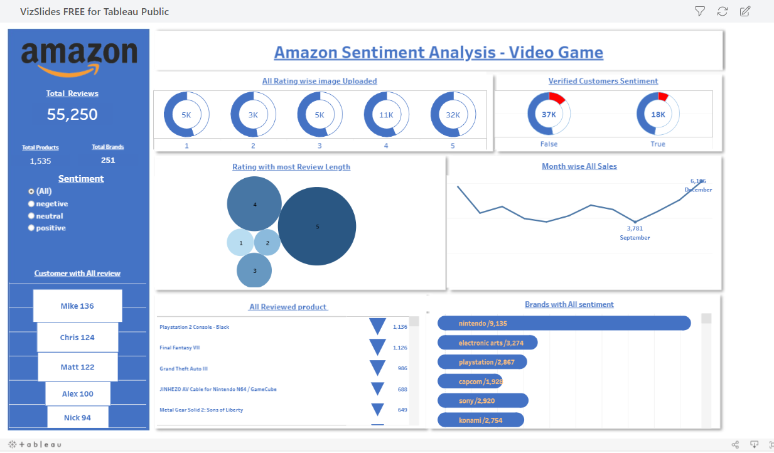

Slide 14
BUISNESS INTERPRETATION
Video Game Data
Brand :
EA, Sony and Playstation are next most reviewed Brand.
Advertising EA, Sony & PS would increase the traffic to the amazon store.
Customer Satisfaction :
Bryan19 , Matt16 and other Customers had the most negative reviews.
Providing them extra services would benefit the reputation and profits. Eg Amazon pay Coupons.
Sentiment :
36% of the Data is Neutral and 12% is Negative
By Targeting these Specific Products and Brands, providing better services in the future would increase the profits.
As per the Prediction the Negative sentiment shows a growing trend.
13

Slide 15
Amazon Product Review on Toys & Game

Slide 16
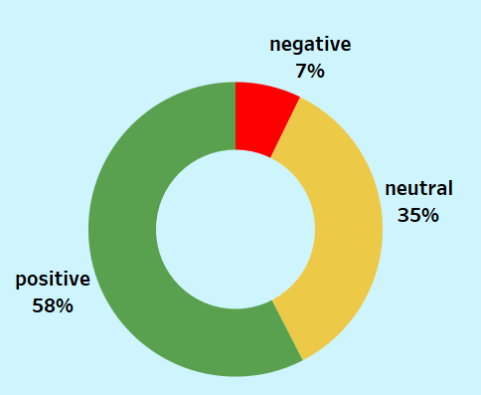
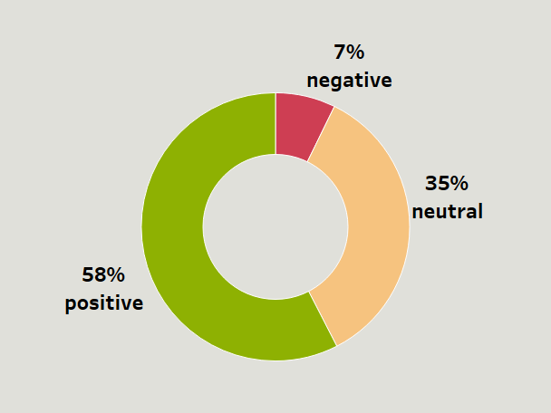
Analysis on Brands and product
Conclusion:-
58% of the Customers like the products manufactured from Melissa, Hasbro, Crayola, Fisher and Learning Resources
And, We can recommend the games such as Days of wonder, The Elf on the Shelf, Stomp Rocket, Snap Circuits Classic and Qwirkle
16

Slide 17
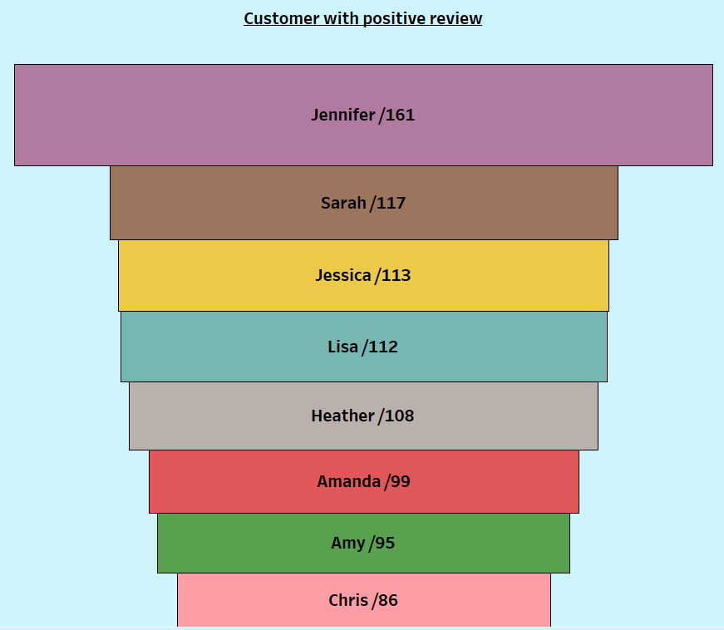
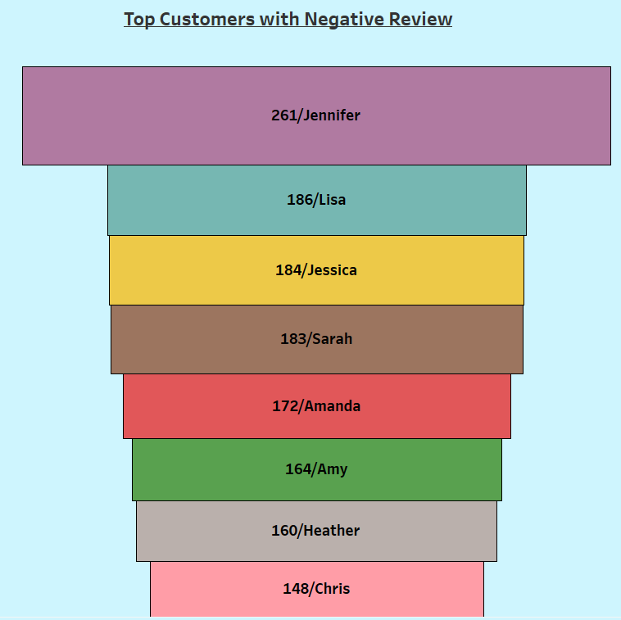
Valuable Customers
Conclusion:-
Above customers such as Jennifer, Sarah, Jessica, Lisa, Heather, etc has share the positive as well as negative review for the product.
So, we can conclude they are the genuine customers and to improve the productivity we should consider their reviews
17

Slide 18
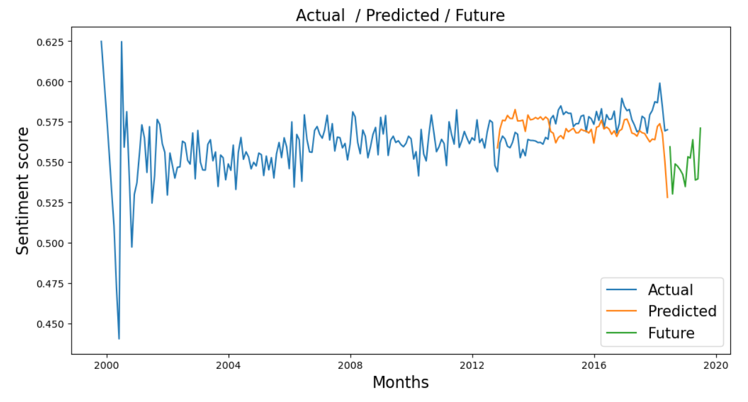
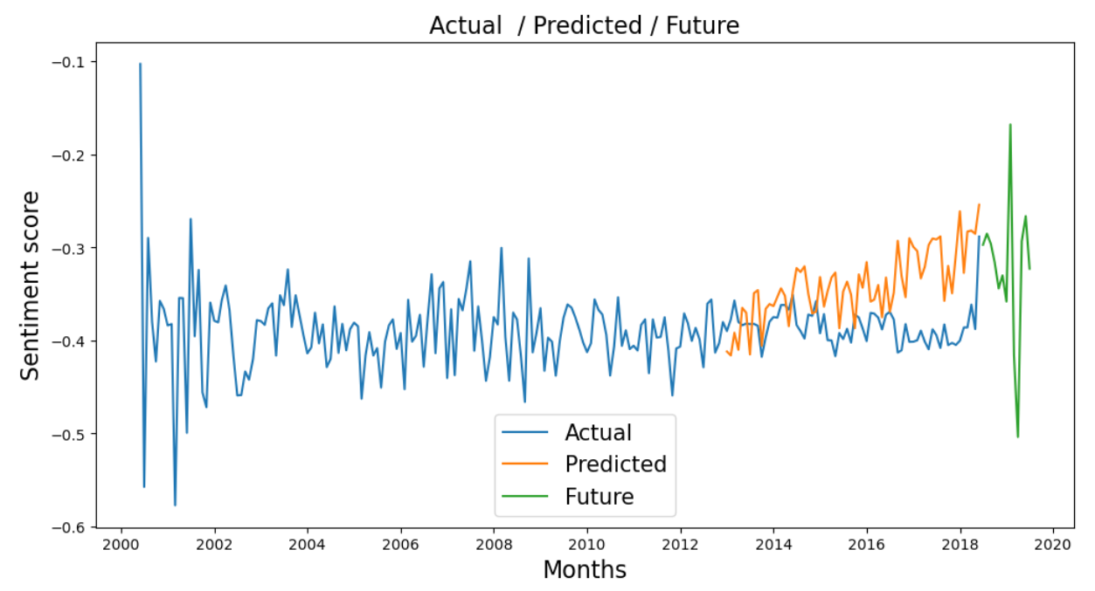
Forecast of Positive and Negative Expressions
Positive
Negative
Conclusion:- Above Plot is the future forecasting of the product positively and negatively using a SARIMAX model.
18

Slide 19
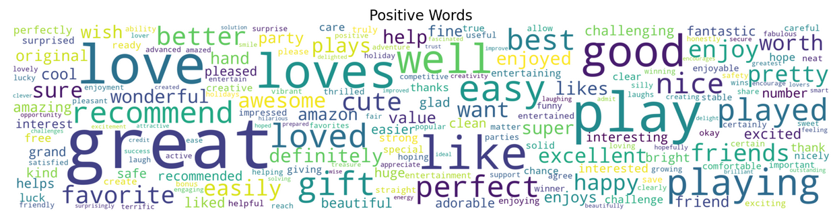
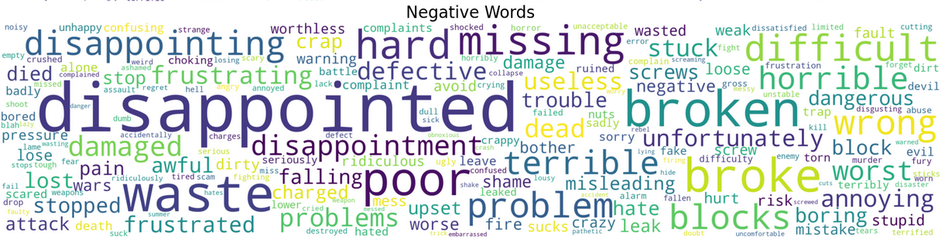
Text Analysis based on Reviews
The positive word cloud for Amazon reviews is dominated by words such as "great," "love," "amazing," and "excellent," suggesting overwhelmingly positive sentiment among reviewers. The positive word cloud overall paints a picture of a community of happy and satisfied Amazon customers
The negative word cloud features words like "disappointed," suggesting a sense of unmet expectations, and "missing," indicating a sense of loss or absence. Overall, the negative word cloud paints a picture of a person or community that is struggling with disappointment, loss, dysfunction, and a sense of waste.
19

Slide 20
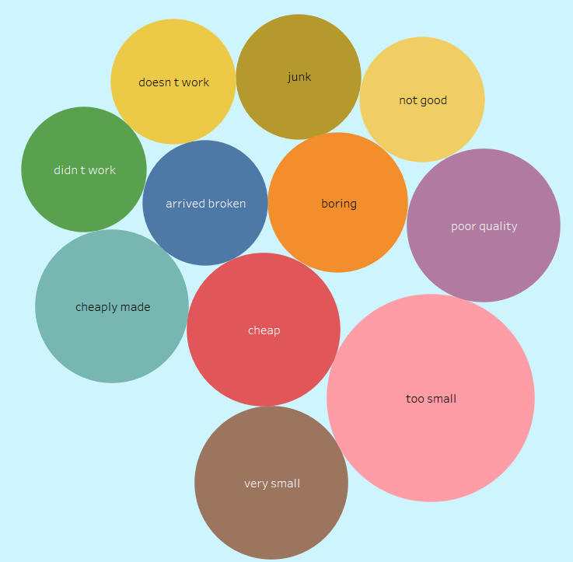
Text Analysis based on
Negative Reviews
20

Slide 21
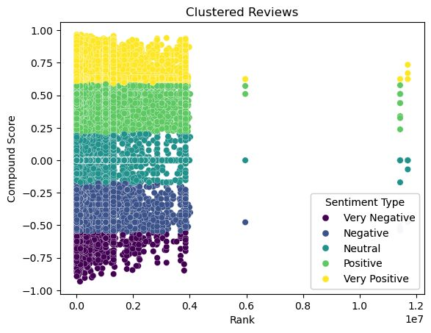
Clustering customers using Machine learning
In conclusion, our K-means clustering analysis of Amazon goods based on their rating and rank identifies five unique groups.
These clusters can help guide ranking and product strategy decisions in order to better satisfy the demands and preferences of customers.
According to rank, clusters 1 and 2 are negative, cluster 3 is neutral, and clusters 4 and 5 are positive.
21

Slide 22
MODEL EVALUATION
Toys and Games Data
Stacking (Logistic Regression) :
Accuracy Score : 95.29 %
F1 Score : 94.97 %
Recall Score : 95.29 %
Precision Score : 95.17 %
Naïve Bayes Classifier Model :
Accuracy Score : 85.35 %
F1 Score : 86.27 %
Recall Score : 85.35 %
Precision Score : 87.37 %
In conclusion, we compare our model to logistic regression, Naive Bayes, and Ensemble(random forest classifiers) from that logistic regression evaluation for Amazon product ratings based on review text good results measured using accuracy, F1 score, recall, precision, and a confusion matrix.
22

Slide 23
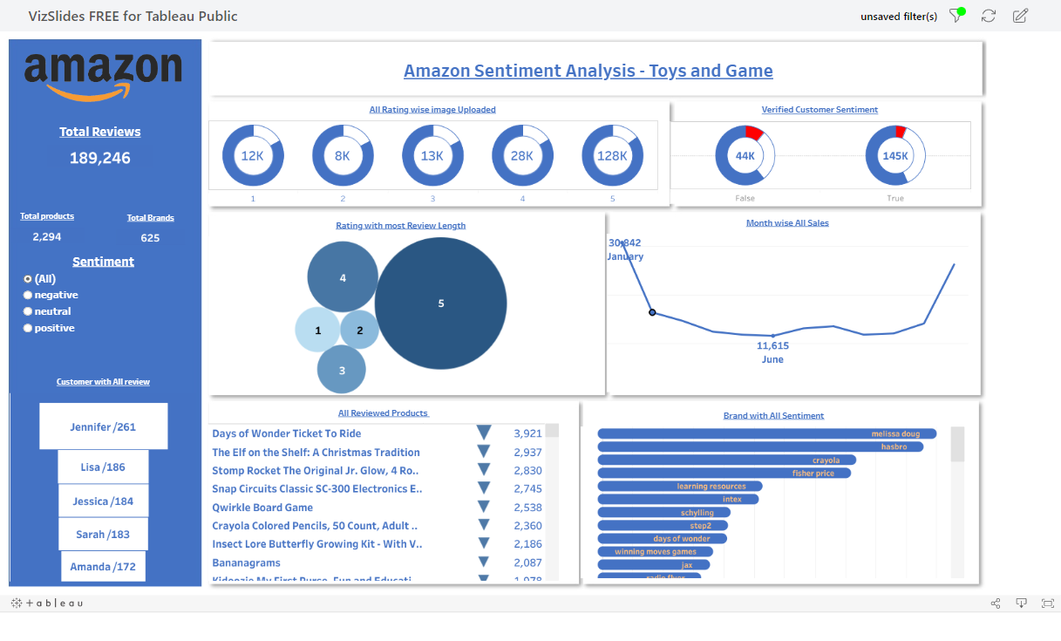

Slide 24
BUISNESS INTERPRETATION
Toys & Game Data
Brand :
Melissa doug, Hasbro and Crayola are next most reviewed Brand.
Advertising Melissa doug, Hasbro & Crayola would increase the traffic to the amazon store.
Customer Satisfaction :
Amanda , Lisa and other Customers had the most negative reviews.
Providing them extra services would benefit the reputation and profits. Eg Amazon Pay Coupons.
Sentiment :
35% of the Data is Neutral and 7% is Negative
By Targeting these Specific Products and Brands, providing better services in the future would increase the profits.
As per the Prediction the Negative sentiment shows a Faintly growing trend.
23

Slide 25


Conclusion and Business Recommendations
In month May, June and September has recorded with maximum negative reviews. The changes should be done prior to this months.
Negative feedback are because of Quality is not up to mark, Customers are unable to understand Instructions and customers want some upgradation in the product due to which they are lacking with the motivation to play.
Certain clients who buy products on a regular basis and are prepared to sacrifice should be given special consideration e.g. Jennifer, Sarah and Lisa
Another reasons for the unfavorable reviews is that there were several products were delivery was late and packing was not proper so the product got damaged.
Overall, Addressing negative reviews is important for amazon to maintain its reputation and customer loyalty by Improving product quality, Respond to reviews , Offer refund or exchange and provide better information of product.
25

Slide 26


